Slide 1

Movie Industry

Slide 2
Business problem
What are the movie categories in the market?
Which movie categories people are interested in and have ratings?
Which movie categories are most profitable for investment?

Slide 3
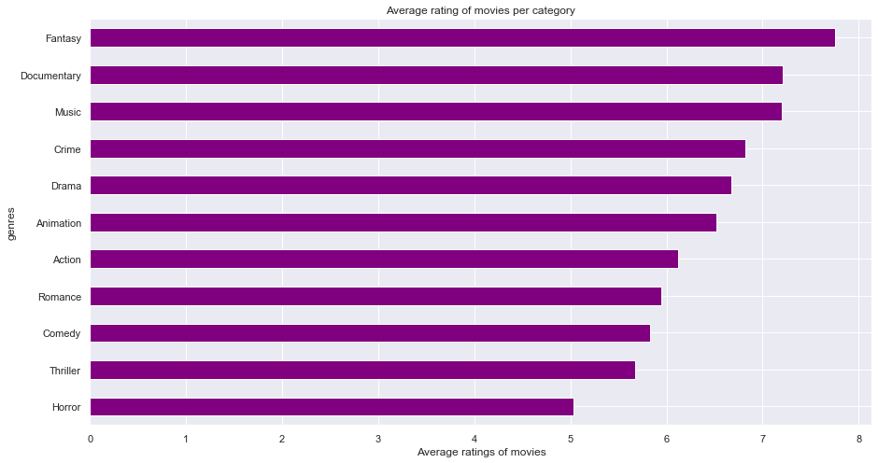
Average rating per movie category

Slide 4
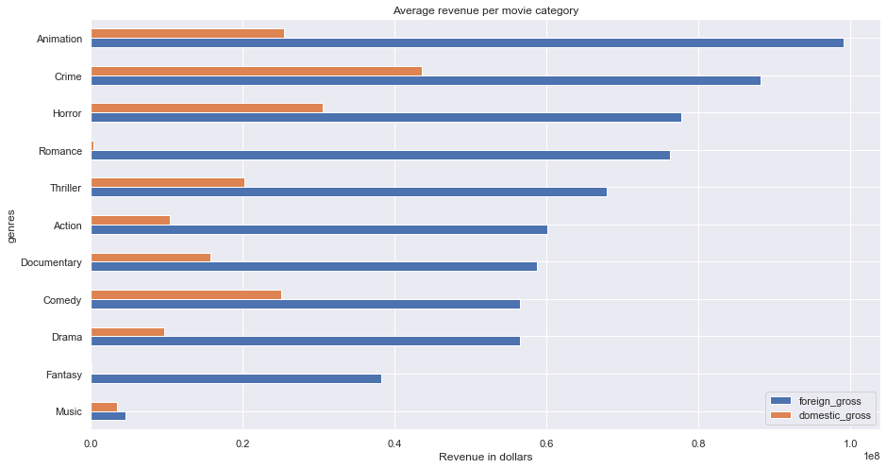
Average revenue per movie category

Slide 5
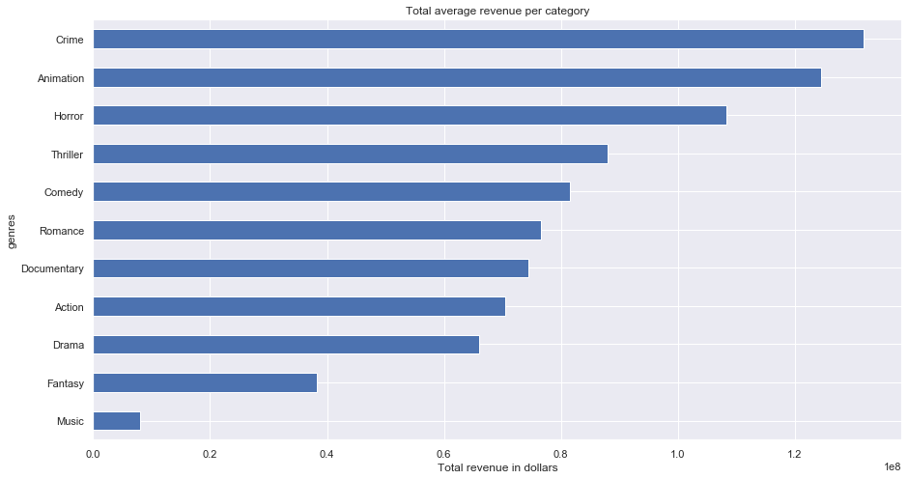
Average total revenue per movie category

Slide 6
Correlation factor
Correlation factor between average rating of movies and national revenue : -0.09
Correlation factor between average rating of movies and international revenue: 0.017
Correlation factor between average rating of movies and total revenue : -0.02

Slide 7

Regression model
Linear regression model for total revenue and movie categories

Slide 8


Regression model
Multiple linear regression for movie ratings , national and international revenues.
Linear regression for movie ratings and total revenues

Slide 9
Conclusion
The first 3 movie categories with the most revenues as calculated by total revenues are: Crime, Animation, Horror.
Movie categories with highest average ratings: Fantasy, Documentary and Music.
Negative correlation factor between ratings of moves and total revenues.
Microsoft can start movie business producing movies in the following categories: Crime, Animation and Horror

